Slide 1
AALO Smart Board
High Marketing Less Costing

Slide 2
What is AALO Smart Board?
It is a digital version of bill board. It is full server based. It can operate anywhere in the world through internet. It has an emergency bulletin scrolling, company logo, image & video. It might be placed in the different place like School, College, University, Hospital, Restaurants, Shopping Center, Bill Board etc.

Slide 3
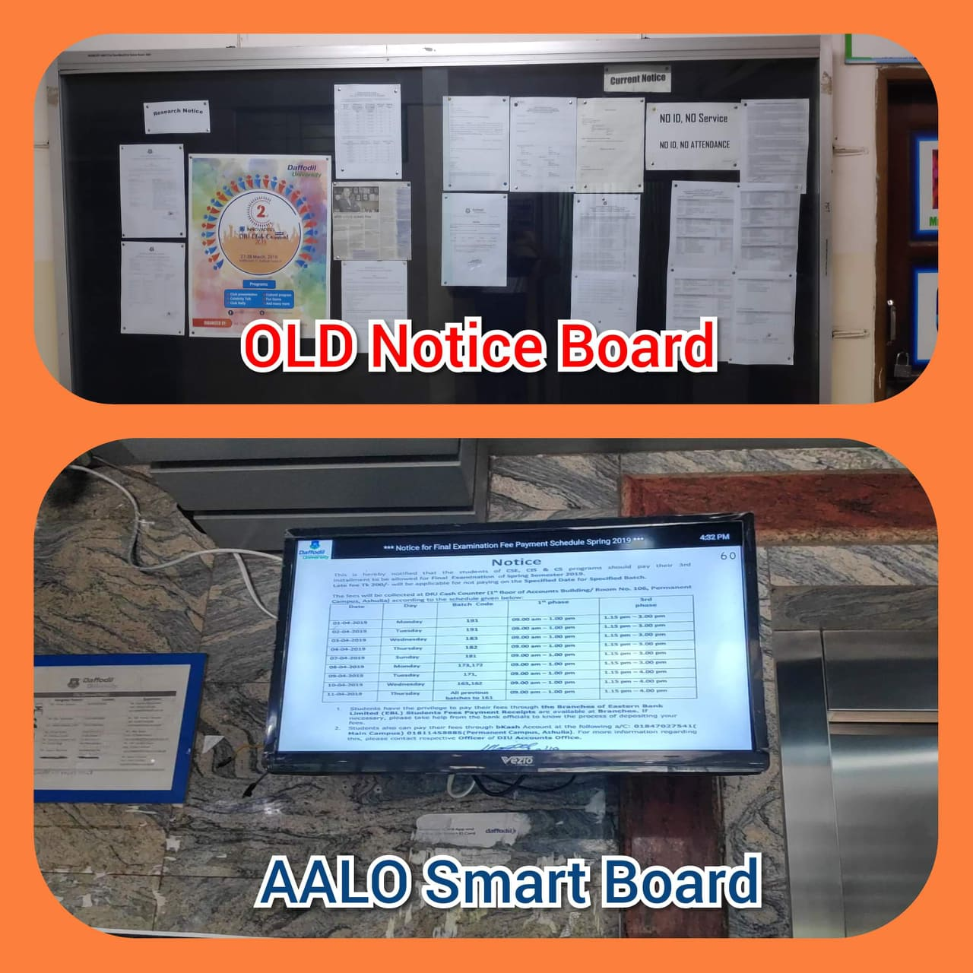

Slide 4
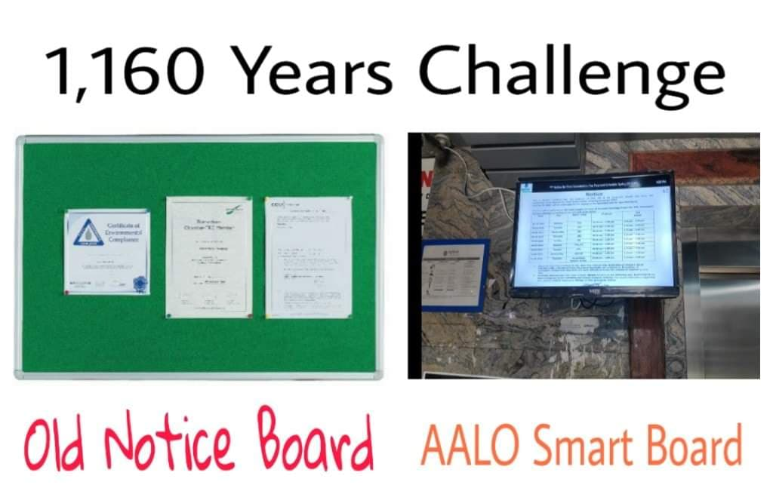
Now Running on Daffodil CSE Building

Slide 5

Hospital Demo

Slide 6
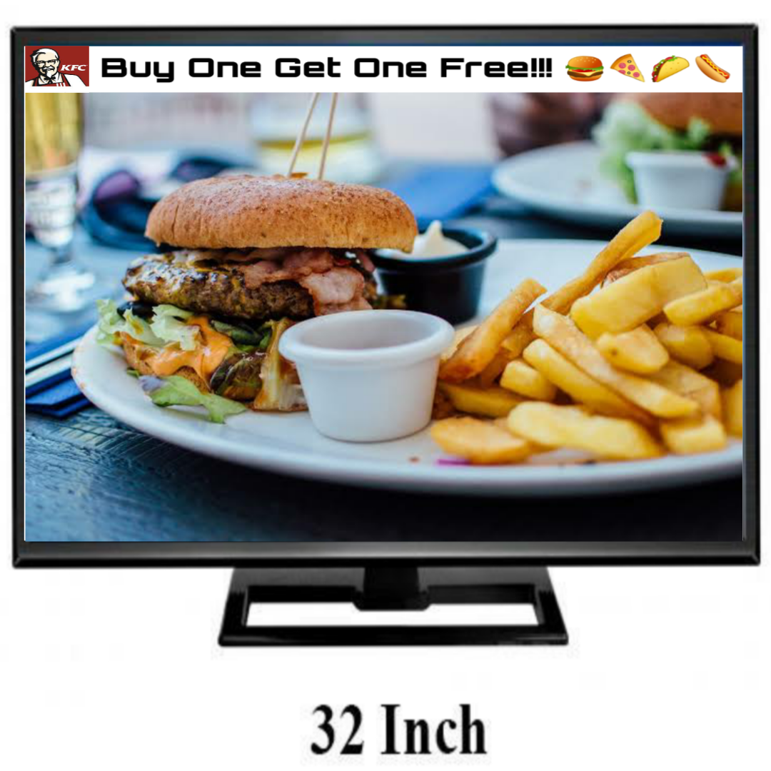
Restaurant Demo

Slide 7

Bill Board Demo

Slide 8

Digital Classroom

Slide 9
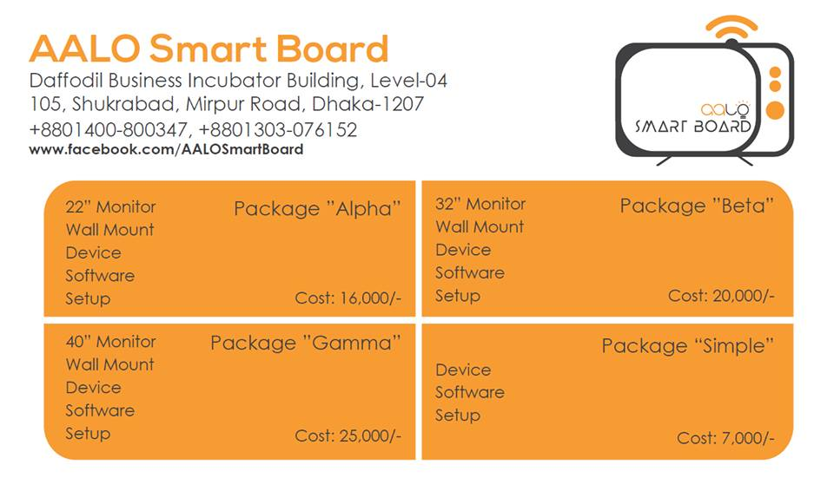

Slide 10
Objective
This is the digital version of old notice board.
Marketing own place.
You can use the full Screen of monitor without logo & headline.
We have 30 & 60 second both image duration.
It is fully automated.
It starts and shut down automatically with your required time.

Slide 11
Vision
This product is under AALO Group.
Provide this product worldwide.
Make it’s own company.
Less costing.
Make it more attractive.
Spread the market size.

Slide 12
Fund Need For Development
Marketing 2,00,000 ( 6 month )
Office cost: 4 month 3000*4=12,000 ( 4 month )
Employee salary: 3*6000*4 = 72,000 ( 3 employee 4 month 6000\per )
Total: 2,84,000 ( 2 lakh 84 thousand Taka )

